Slide 1
WELCOME TO
DAT11: DATA SCIENCE
Course Instructor: Paul Goodall
Astrophysicist, Data Scientist, Explorer

Slide 2
AGENDA

Slide 3
AGENDA
AGENDA (infinite loop?)
Introductions – all!
About this course
Expectations – Course Structure
Expectations – Lesson Structure
Expectations - What the course IS
Expectations - What the course IS NOT
Expectations – Adult learning environment
Icebreaker (15-mins) – all!
ROE – Rules of Engagement - all
Data Science lesson 1

Slide 4
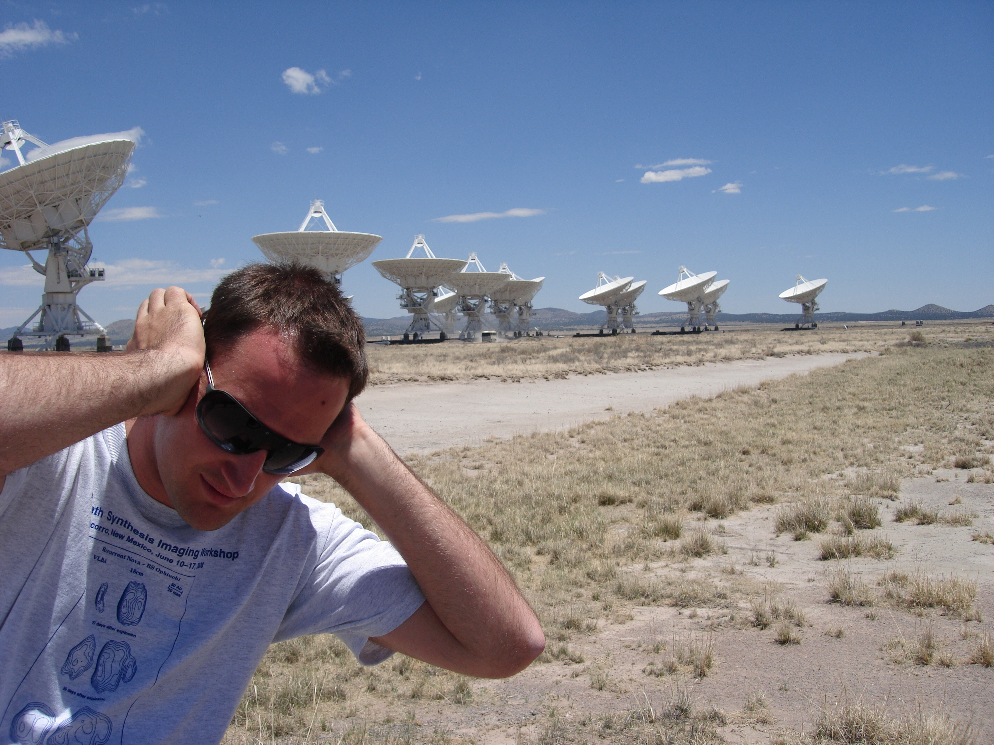
About Me
Welcome to Data Science 11 Sydney!
Here's a bit about me:
Name | Background | Fun Fact
Notes:
Provide your name and brief bio, including: your background in Python programming, any experience you've had with GA, and one "fun fact" about yourself.

Slide 5
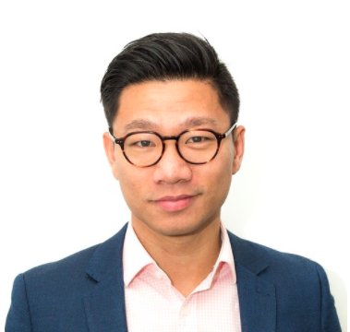
About Me
Welcome to Data Science 11 Sydney!
Here's a bit about James:
Name | Background | Fun Fact
Notes:
Provide your name and brief bio, including: your background in Python programming, any experience you've had with GA, and one "fun fact" about yourself.

Slide 6
About CLASS DAT11
Round Robin for all: Name | Background | Fun Fact
Notes:
Provide your name and brief bio, including: your background in Python programming, any experience you've had with GA, and one "fun fact" about yourself.

Slide 7
ABOUT THE COURSE

Slide 8
Structure of a Typical Lesson
Part 1a - 30 mins
- Instructor Presenting
- Students Listening
Statement of Learning Objectives
+ overview
Motivation
examples of practical problems
Theory
Lab
code walk-through
exercises
Discussion
Homework
projects (or project checkpoints), planning
reading
Part 1b - 55 mins
LAB session
10-min break
Part 2a - 30 mins
- Instructor Presenting
- Students Listening
Part 2b - 55 mins
LAB session

Slide 9
What the course IS What the course IS NOT
A whirlwind tour of the Data Science toolkit a way for professionals who haven’t done Data Science before, to get some exposure to what Data Science is all about
A Platform an enabler for professionals to kick-start a successful career in Data Science
For beginners / inexperienced technical professionals
Everything you need to instantly equip you as a world-class Data Scientist…. This cannot be done in 60 hours! Takes many year experience of DOING Data Science
NOT an advanced course – please be patient if others are less experienced and require more time

Slide 10
An efficient adult learning environment
Learn by doing!
Leverage experience of Course Instructor and TA
Leverage experience of other students in class
Core values:
Professionalism
Respect
Fun
Honesty
Motivation, Enthusiasm & Contribution
Anything else ??

Slide 11
Ice Breaker!

Slide 12
Rules of Engagement

Slide 13
DATA SCIENCE
Lesson 1, Week 1
Introduction to Data Science
What is data science and how do we apply it?

Slide 14
Learning Objectives
Already done in Intro!
Review Pre-work
Describe the roles and components of a successful learning environment
Define data science and the data science workflow
Apply the data science workflow in a practical example
Set up / test your development environment
Get started with Python!

Slide 15
PRE-WORK

Slide 16
Pre-work Review
Install Anaconda with Python 3.6 onto your computer.
Check that it runs by opening the Navigator application and launching a jupyter notebook from the navigator interface.
Download and install a Github or Git client
Sign up for a public Github account.
Send your Github username to your course contacts.
New platform – class server dat11:
http://www.paulgoodall.tech:8000/
http://128.199.71.237:8000/hub/login
Introduce yourself on the course Slack channel
Put a picture of yourself in your profile.
New solution! Everything already set up for you! ☺

Slide 17
Pre-work Review - cont’d
Read any 2 chapters of the Data Science Handbook (www.thedatasciencehandbook.com/)
Read the first 2 chapters of Introduction to Statistical Learning (http://www-bcf.usc.edu/~gareth/ISL/ISLR%20Fourth%20Printing.pdf)
Complete the Intro to Python for Data Science course on DataCamp (https://www.datacamp.com/getting-started?step=2&track=python)
We will expect to see the certificate.

Slide 18
DATA SCIENCE BASELINE

Slide 19
What does “Data Science” mean to you?
Initial Thoughts on a whiteboard:

Slide 20







Your First Assignment is: Yourself!
What would you like to get out of this course?
Are you using analytics in your work right now?
What projects have you worked on?
What projects are you planning?
Are you using Python?
Are you using any other data science tools?
Is there a special topic or application area you would like us to cover in the lessons?
Post your answers to our Slack channel: http://dat11syd.slack.com/ #general (meggan@ga.co)

Slide 21
WHAT IS DATA SCIENCE?

Slide 22
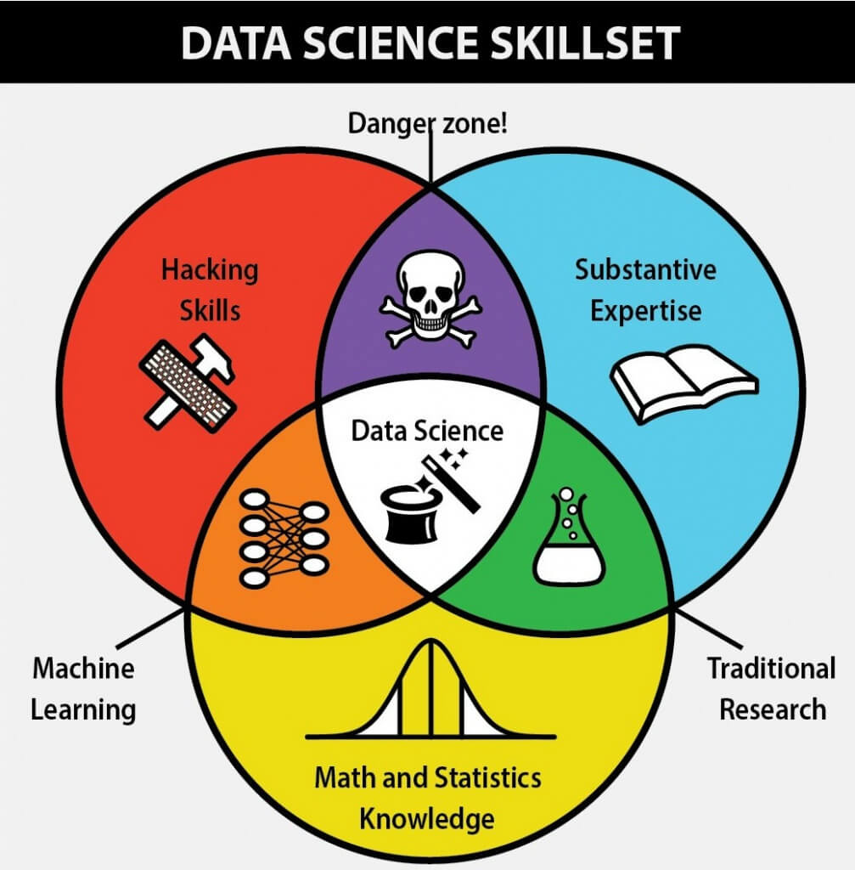
What is Data Science?
Million-$ Question.
GA’s summary:
A set of tools and techniques for analysing data
Interdisciplinary problem-solving
Application of scientific techniques to practical problems
Source: Berkeleysciencereview

Slide 23









Who Uses Data Science?
Other examples?

Slide 24
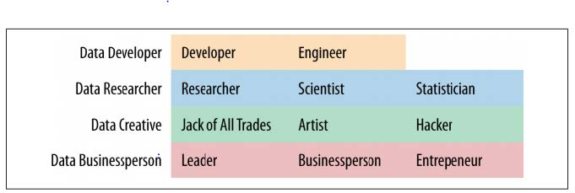
What Are the Roles in Data Science?

Slide 25
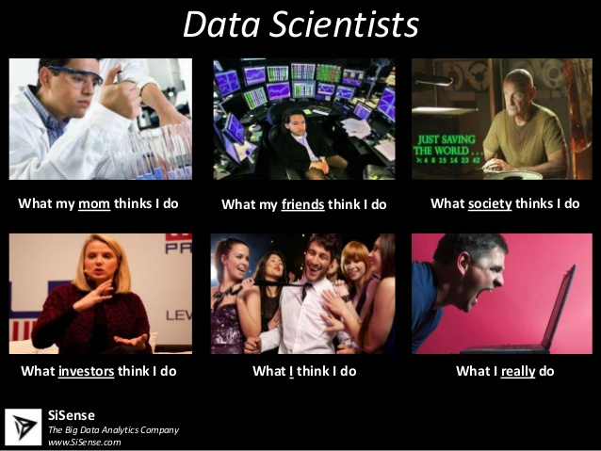
What do Data Scientists do?

Slide 26
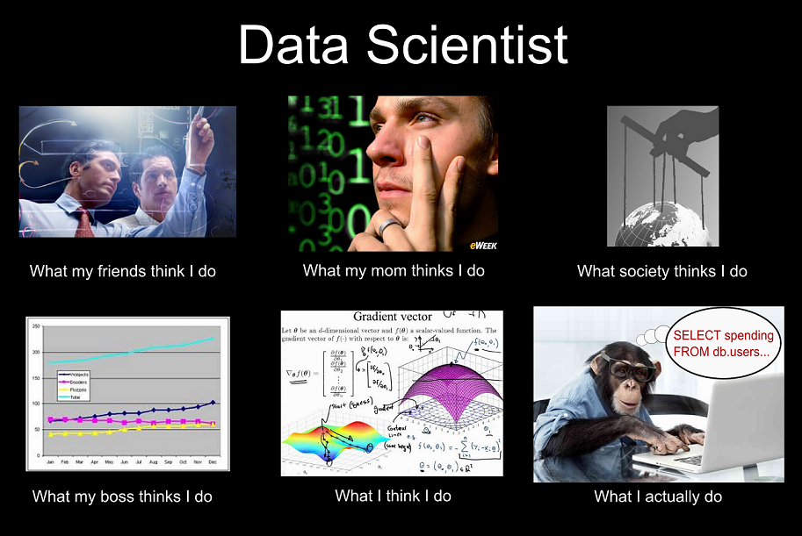
What do Data Scientists do?

Slide 27
Where Do Data Scientists Come From? And what are their typical strengths?
 | Hacking Skills | Math & Stats | Substantive Expertise | Methodology | Abstraction | Communication
Data Science program graduates
Scientists (especially physics)
Statisticians
Developers
Business Analysts

Slide 28
Data Science Skill Sets
Business
ML / Big Data
Applied Math
Programming
Statistics
Product Development Domain Knowledge Data Collection Data Storytelling
Algorithm Design Linear Algebra Matrix Calculations Model Optimization Dimensionality Reduction
Structured Data Unstructured Data Graph Data Distributed Data Parallel Processing
Data Acquisition Data Cleaning Object-Oriented Programming Database Administration Data Engineering Natural Language Processing
Spatial Statistics Temporal Statistics Descriptive Statistics Data Visualization Feature Selection Multi-Armed Bandit Study Design Model Evaluation

Slide 29
THE DATA SCIENCE WORKFLOW

Slide 30
Features of the Data Science Workflow
A methodology for doing Data Science
Similar to the scientific method
Helps produce reliable and reproducible results
Reliable: Accurate findings
Reproducible: Others can follow your steps and get the same results

Slide 31
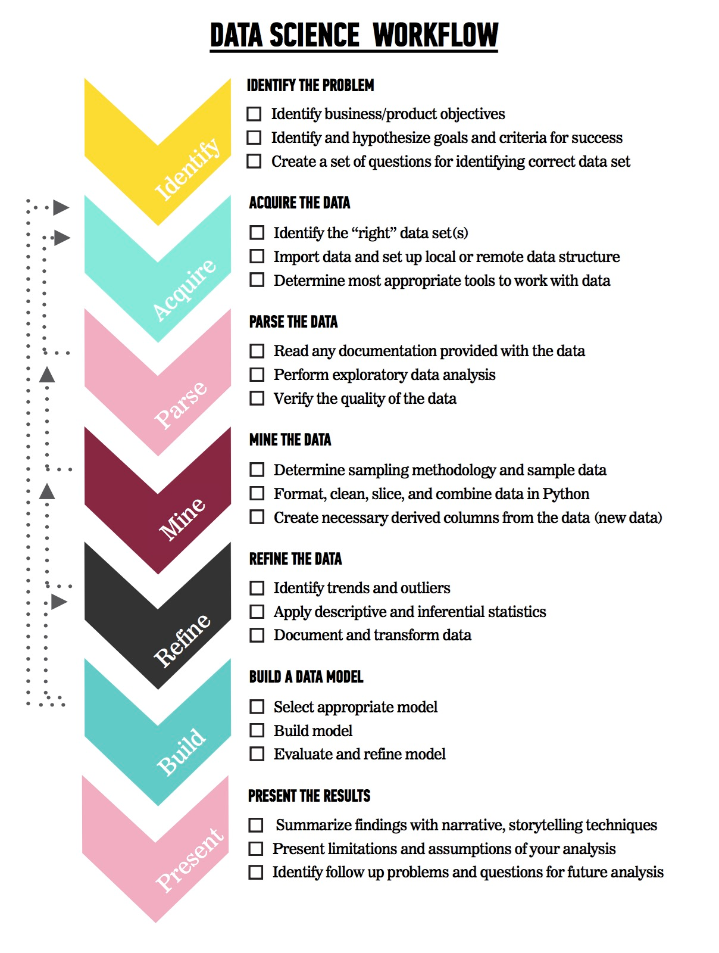
Overview of the Data Science Workflow
The steps:
Identify the problem
Acquire the data
Parse the data
Mine the data
Refine the data
Build a data model
Present the results

Slide 32
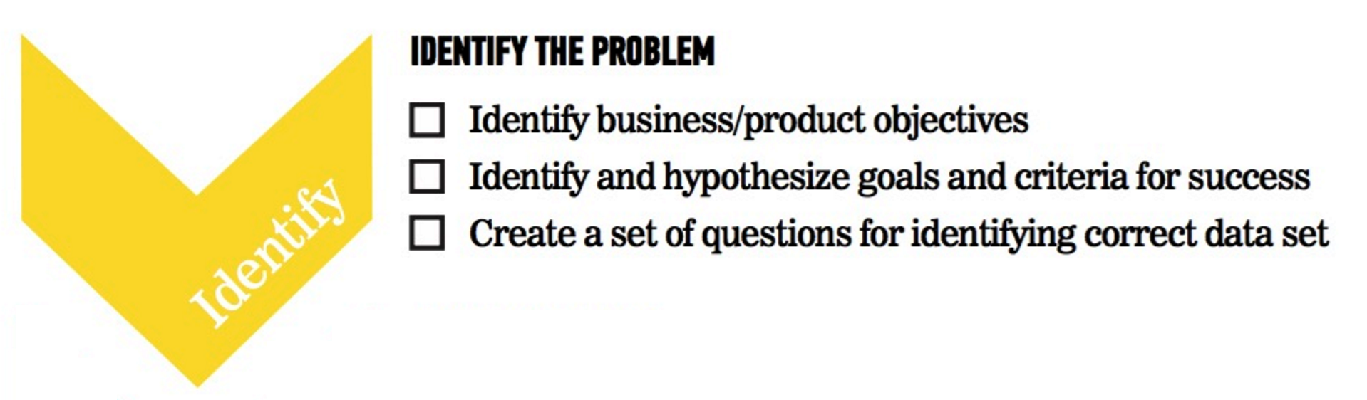
Overview of the Data Science Workflow

Slide 33
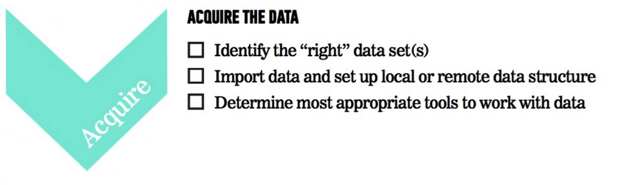
Overview of the Data Science Workflow

Slide 34
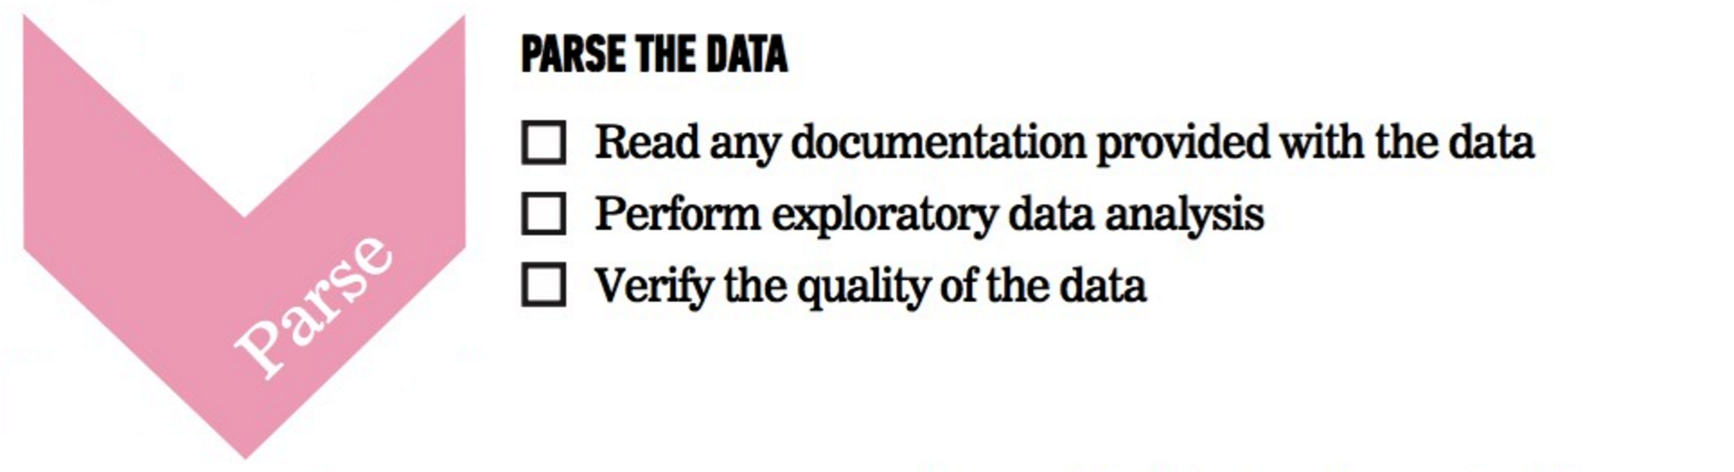
Overview of the Data Science Workflow

Slide 35
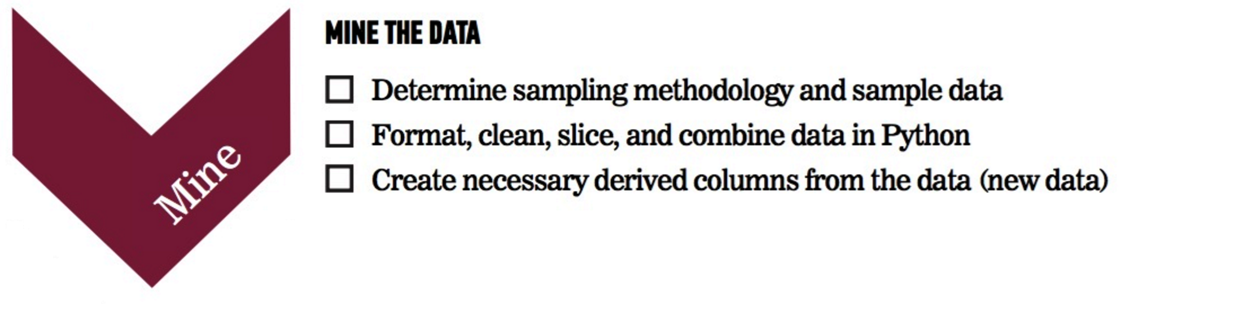
Overview of the Data Science Workflow

Slide 36
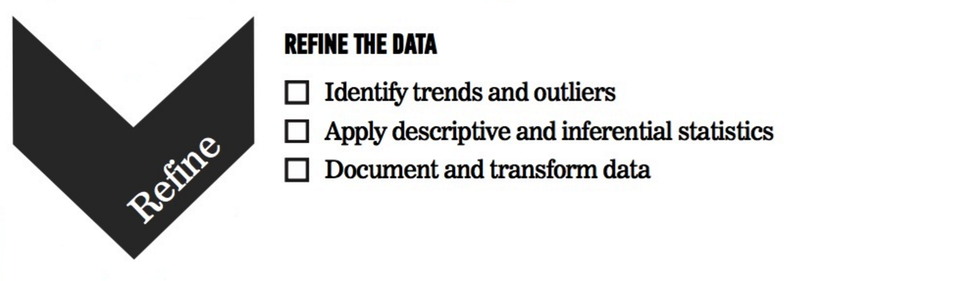
Overview of the Data Science Workflow

Slide 37

Overview of the Data Science Workflow

Slide 38
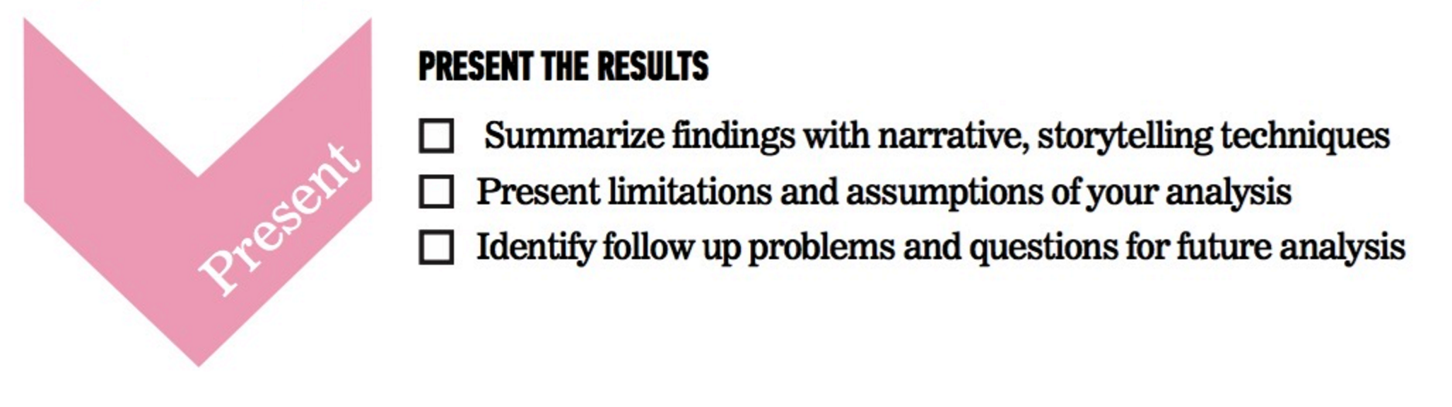
Overview of the Data Science Workflow

Slide 39
GUIDED PRACTICE
DATA SCIENCE WORKFLOW

Slide 40

ACTIVITY: DATA SCIENCE WORKFLOW
DIRECTIONS (30 minutes)
There are 5 example presentations available for review at the link:
https://github.com/generalassembly-studio/dat11syd/tree/master/lessons/lesson-01/2_groupwork
Divide into 5 groups
Review one of the 5 final presentations selected from a past DAT course
Discuss with your team:
EXERCISE
Is it clear what the Data Science question is?
Did the student communicate the problem space clearly?
Did the student stick to the data science workflow as a framework?
Did the student explain what their assumptions where and potential flaws?
Did the student achieve?
What would you do better if you did this project again?
DELIVERABLE
Presentation of the results

Slide 41
GUIDED PRACTICE
USING THE ENVIRONMENT

Slide 42
Dev Environment – old!
Environment setup
Github account + Git client
Python 3.6 + Anaconda
Python syntax, Pandas, Terminal commands
iPython Notebook test
Python review
magics
Github review / test

Slide 43
Dev Environment – New!
First name | Last name | Username | Password
Paul | Goodall | dat11_paul
James | Lai | dat11_james | monkey_9
Akif | Alim | dat11_akif | monkey_9
Mai | Anh Ly | dat11_mai | monkey_9
Bernadette | Basha | dat11_bernadette | monkey_9
Swernim | Bhardwaj | dat11_swernim | monkey_9
Suren | Chandrasekera | dat11_suren | monkey_9
Renee | Checchin | dat11_renee | monkey_9
Sophia | Cherem Lopes | dat11_sophia | monkey_9
Sung | Choi | dat11_sung | monkey_9
Jesse | Imer | dat11_jesse | monkey_9
Bridget | Loudon | dat11_bridget | monkey_9
Alex | McCauley | dat11_alex | monkey_9
John | Niyonsaba | dat11_john | monkey_9
Andrew | Ren | dat11_andrew | monkey_9
Michael | Tostee | dat11_michael | monkey_9
Ricardo | Valencia | dat11_ricardo | monkey_9
Evan | Wong | dat11_evan | monkey_9
Jon | Workman | dat11_jon | monkey_9
Linna | TBC | dat11_linna | monkey_9
New platform – class server dat11:
http://www.paulgoodall.tech:8000/
http://128.199.71.237:8000/hub/login

Slide 44
Logging in

Slide 45
Welcome to Jupyter Hub
Select “Terminal”
Nothing here yet!

Slide 46
Welcome to Jupyter Hub
Type the command: passwd and follow the prompts to change your login password. WRITE IT DOWN.

Slide 47
Introduction to the Unix COMMAND LINE
Begin this tutorial from slide 15
Use the left and right arrow keys to navigate
https://software.rc.fas.harvard.edu/training/intro_unix/latest/#(15)

Slide 48
CONCLUSION
REVIEW

Slide 49
Conclusions
You should now be able to answer the following questions:
What is Data Science?
What is the Data Science workflow?
How can you have a successful learning experience at GA?

Slide 50
Additional Resources
Data Science Central
http://www.datasciencecentral.com/
Python.org
https://www.python.org/about/
Amazon
books on Python & Data Science
LinkedIn
groups
538 (Nate Silver)
http://fivethirtyeight.com/

Slide 51
Optional Review
Probability & Statistics
Bonus: Additional Practice
Python Syntax
Bonus: Additional Practice (Exercises 1-20)
Git Tutorial
Bonus: Additional Practice
Command Line Overview
Bonus: Additional Practice

Slide 52
DATA SCIENCE
BEFORE NEXT CLASS

Slide 53
Before Next Class
Finish course prework
First Assignment
Practice Python programming (Python for Data Science course on DataCamp)
Join Kaggle
https://www.kaggle.com/

Slide 54
Q & A

Slide 55
EXIT TICKET
DON’T FORGET TO FILL OUT YOUR EXIT TICKET
https://docs.google.com/forms/d/e/1FAIpQLSdaBdMebhoXQpac2edDbIkHD-78HrTpBk3VKGH6lcDMVorSIQ/viewform

